Slide 1

ScreamSense: Real-Time Scream Detection Using Machine Learning
Revolutionizing security, safety, and monitoring through sound detection technology.

Slide 2

The Problem: Delayed or Missed Emergency Alerts
Current audio monitoring systems lack precision in recognizing emergencies.
Human error causes 30% delay in critical emergency responses.
Immediate and automated threat detection is urgently needed.

Slide 3

Introducing ScreamSense: AI-Powered Solution
Real-time scream detection
95% accuracy
Identifies screams clearly amid background noise.
Uses advanced machine learning for instant threat alerts.
Seamless integration
Works smoothly with existing security infrastructures.

Slide 4
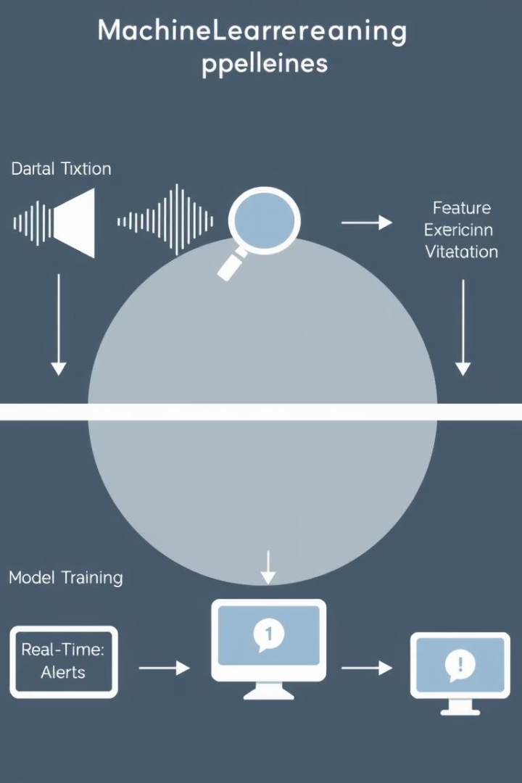
How ScreamSense Works: Machine Learning Pipeline
Data Collection
10,000+ hours of scream audio samples gathered.
Feature Extraction
Uses MFCCs and spectral centroid for sound analysis.
Model Training
Deep CNNs trained for precise scream detection.
Real-time Analysis
Processes audio under 0.5 seconds for instant alerts.

Slide 5
Key Features & Benefits
High Accuracy
Real-Time Alerting
Customizable Sensitivity
Privacy-Focused
80% fewer false positives than traditional systems.
Immediate notifications to security and emergency teams.
Processes data on-device, protecting user privacy.
Adjust detection to fit any environment or noise level.

Slide 6





Use Cases: Transforming Safety and Security
Security Systems
Child Monitoring
Elder Care
Immediate response for falls or distress signals.
Detect distress in vulnerable or high-risk areas instantly.
Parents receive real-time alerts during emergencies at home.
Public Safety
Detect aggression or threats in public spaces early.

Slide 7

Technical Specifications
Optimized for Edge Devices
Runs efficiently on low-power hardware like Raspberry Pi.
Connectivity Options
Supports Wi-Fi, Bluetooth, and cellular networks seamlessly.
API Integration
Works smoothly with popular security and monitoring platforms.
Scalable Deployment
Adaptable for use across multiple devices and locations.

Slide 8
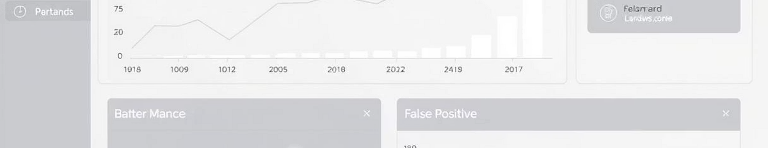
Performance Metrics: Accuracy & Latency
Accuracy
95% precision, 92% recall
Latency
Detection within 0.5 seconds
False Positive Rate
0.05% in controlled tests
Validation
Independent tests by SecurTech Labs (Q3 2024)

Slide 9

Market Opportunity & Competitive Advantage
Audio-based security market projected to reach $5B by 2027.
ScreamSense leads in accuracy and detection speed.
First-mover advantage in specialized scream detection tech.
Proprietary algorithm currently pending patent approval.

Slide 10

Call to Action: Partner with ScreamSense
Create Safer Spaces
Pilot Opportunities
Collaborate
Join us to build responsive, secure environments.
Participate in exclusive pilot programs.
Contact us to explore partnership options.

